Slide 1
Object-Oriented Programming

Slide 2
A Paradigm
A strategy for organizing data and functionality together
Data, also referred to as properties, attributes, variables
Functionality, is code in the form of methods
OOP allows us to create out own data types.

Slide 3
A Familiar Example
We often cite Strings as a primitive data type.
However, Strings have: Data: the character data of the String Functionality: String methods that can be called using dot notation
String myString = “some string data”;
JAVA PYTHON
myString.toUpperCase() myString.upper() myString.indexOf(“r”) myString.isalpha()
The code for these String Methods is stored inside the object’s class, which we’ll see next.

Slide 4
Terms: Class and Object
Two frequently used terms. Not the same, but closely related.
Classes are templates, like a cookie cutter.
Generally define the data/properties that will need to be stored (size, color, shape, etc…)
Also defines any functions that we want to include.
Once the class has been made, objects can be created from it
Objects are instances of a class, and are like the cookies.
Not all cookies need to be identical. Properties can be different from object to object

Slide 5
Anatomy of a Class
There are typically 3 sections in a class
1. Properties – all the information the class will contain
2. Constructor – a special function that is called only once, when the object is being created (initialized).
Provides an opportunity to initialize the class properties. Can take 0 or more arguments.
3. Functions – A class may have 0 or more functions, which can be called by any object created from the class, using dot notation.

Slide 6
Simple Example – a Cookie Class
class Cookie { //note: whole class is wrapped in script brackets - no parenthesis here.
//Properties String shape; int size; color c; Boolean sprinkles;
//Constructor Cookie(String sh, int si){ //constructor is a function with the same name as the class. No return type is given!
shape = sh; size = si; //initialize two properties with values passed in c = color (random(255), random(255), random(255)); //random RGB color sprinkles = false; //doesn't start with any sprinkles
}

Slide 7
Simple Example – a Cookie Class (2)
//Functions void addSprinkles(){
if (sprinkles == false){ sprinkles = true; } else println("This cookie already has sprinkles!"); }
void takeBite(){ if (size > 0){ size = size - 4; println("Yum!"); } else println("There's nothing left to eat!") }
}

Slide 8

Creating Objects
Once we've finished writing a class, we've essentially created a new "data type“.
To make an object and store it in a variable, we use the new keyword.
Cookie myCookie = new Cookie ("star", 5);
TYPE VARIABLE NAME NEW KEYWORD CALL TO CONSTRUCTOR FUNCTION IN THIS CASE, NEEDS TWO ARGUMENTS

Slide 9

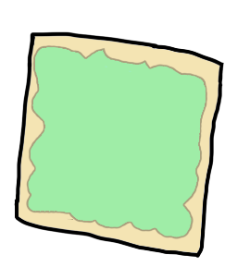
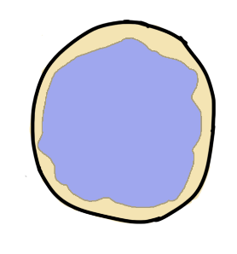

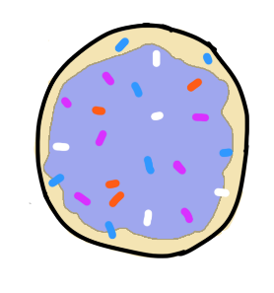
Multiple Objects
Cookie myCookie = new Cookie("star", 6);
Cookie myCookie2 = new Cookie(“square", 8);
Cookie myCookie3 = new Cookie("circle", 8);
each of the three cookies encapsulate their own properties and function(s). The functions can be accessed using dot notation:
myCookie2.takeBite();
myCookie3.addSprinkles();

Slide 10
Objects Demo
We’ll create a generative art program, which will use one or more objects to create an image.

Slide 11
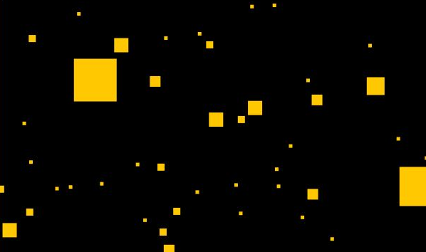
Time to Explore
Continue working with objects, either extending the generative art program, or starting something new from. Some ideas:
User controlled object (keyboard, mouse)
Allow for objects to be created / deleted while the program is running (see ArrayList in Processing ref)
Have objects do something different based on proximity (when close to another object)
Rain animation (when object moves below bottom of screen, reset its position to the top again)

